Slide 1
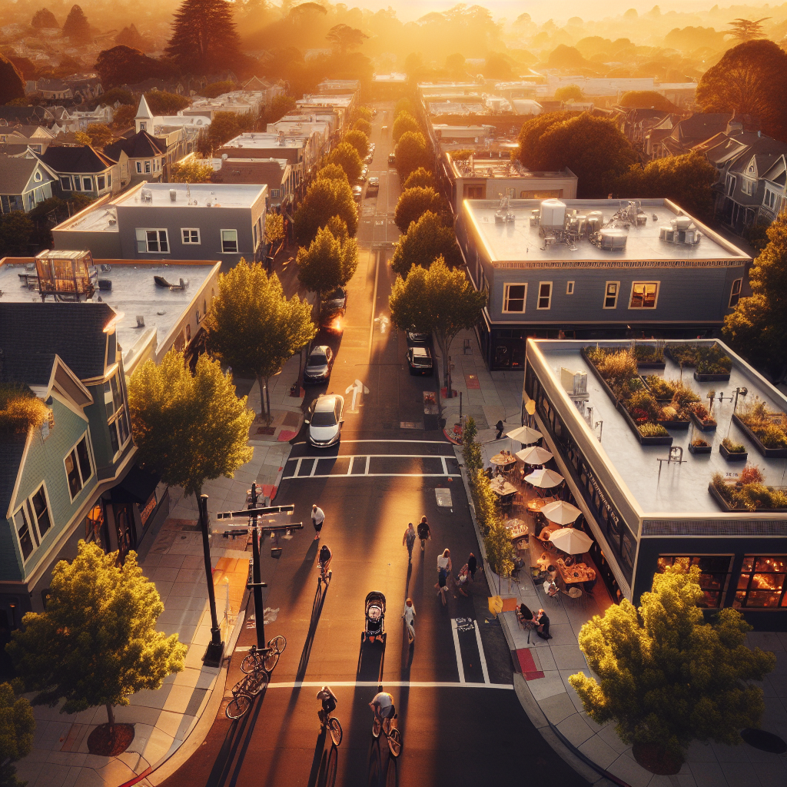
15‑Minute City: Explainer
A human‑scale urban model where most daily needs are reachable within a 15‑minute walk or bike ride.

